Slide 1
Introduction to Python
Sri Ram Sagar K

Slide 2


Origins of Python Programming.
Language Idea is conceived in 1980s and implemented started in 1989.
Centrum Wiskunde & Informatica (CWI) a part of Netherlands Organization for Scientific research.
Father of Python programming language Guido Van Rossum.

Slide 3
Lecture Flow
Step 1>>>> Installation of vanilla python 3.xx.
Step 2>>>> Install Anaconda python IDE.
Step 3>>>> Execution methods.
Step 4>>>> Basic “Hello World” program.
Step 5>>>> Exercise 1.

Slide 4
Step 1>>>> Installation of vanilla python 3.xx.
Go to https://www.python.org/downloads/
Download appropriate executable for your Operating System.
Starting point for learning https://docs.python.org/3.6/tutorial/index.html
New features: https://docs.python.org/3.6/whatsnew/3.6.html

Slide 5
Step 2>>>> Install Anaconda python IDE.
https://www.anaconda.com/download/
Install Anaconda distribution from above Link.
Install Spyder inside Anaconda application.

Slide 6
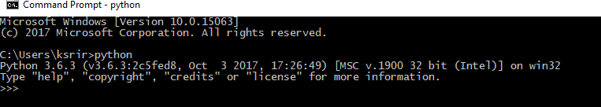
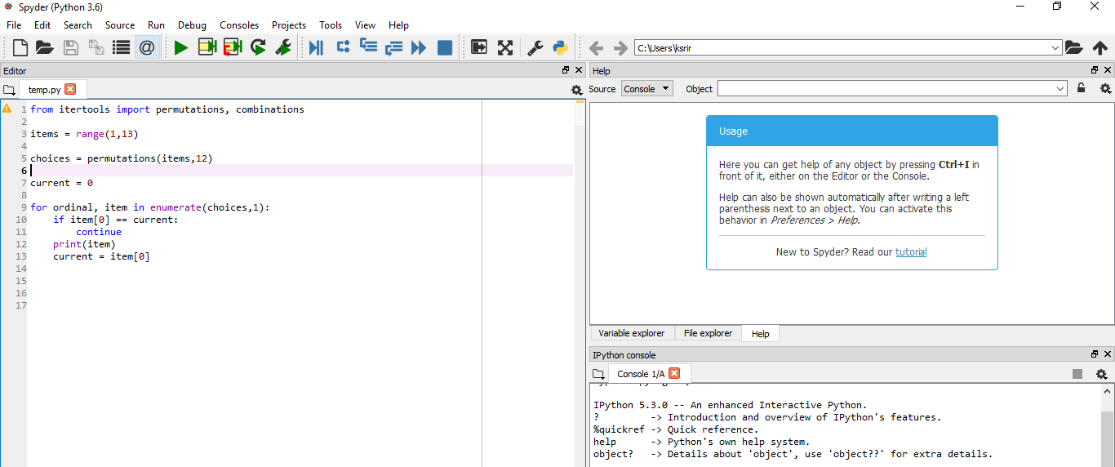
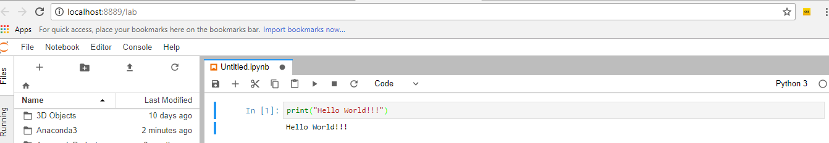
Step 3>>>> Execution methods.
Intrepreter Mode:
Script Mode (Spyder):
Notebook Mode(jupyterLab):

Slide 7
Step 4>>>> Basic “Hello World” program.
Interpreter Mode ‘print(“Hello World”)’
Try it using script mode and Jupyter notebook on jupyterlab environment.
If __name__ == ‘__main__’:
Statement define the start of the python main program.

Slide 8
Step 5>>>> Exercise 1.
Question1 : print this string “hey! I am Trying variation on Print function” in all mode(Interpreter, Script and Jupyter notebook)
Sub-question1 print with using single space and without using intermediate spaces in the given string print function.(hint: check other arguments for print).
Sub-question2 print the give string ending with “python” using end option in print.
Sub-question3 can we write the above string to a text file using print function? If yes what could be the statement.
Question2 : How python identifies the main script of a program.
Question 3: Write about the parameter of print that we did not try in this exercise in a python script comments section (Hint: # is the line comment key character).

